Slide 1


communication
COMMUNICATION WITH COMPUTER HERE

Slide 2
POP OOP
B;BCPL;COBAL;FORTRAN;C…..e.t.c…..
JAVA;PYTHON;.NET;C++
….e.t.c…..

Slide 3




PERFORMANCE
INHERITANCE
POLYMORPHISM
SECURITY
ABSTRACTION
ENCAPSUALTION

Slide 4
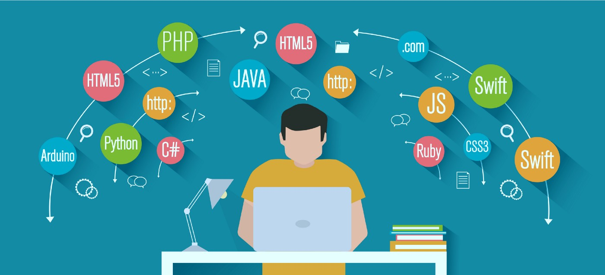
EVOLUTION OF MANY PROGRMMING LANGUAGES
OOPL

Slide 5

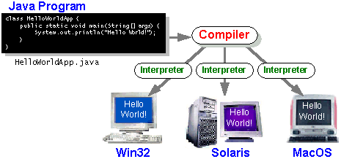
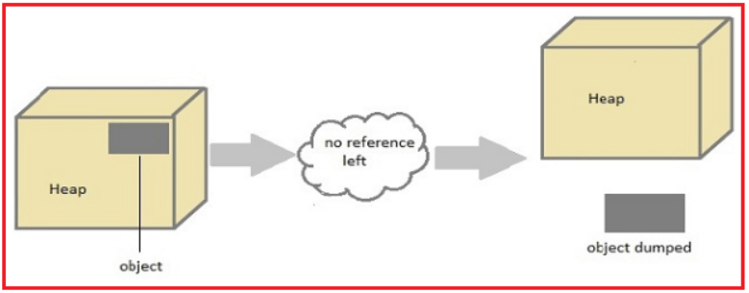
Platform independent
Garbage Collection

Slide 6

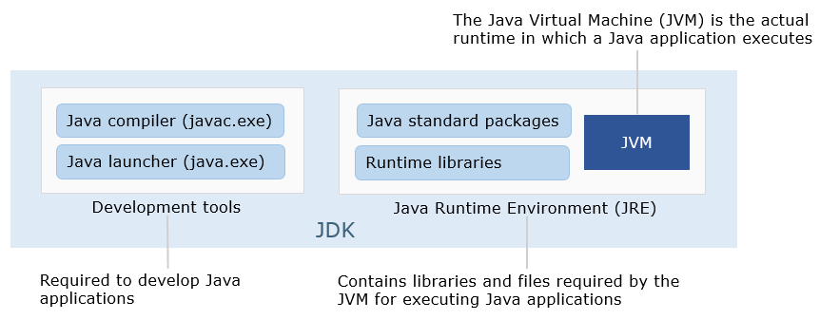
JVM

Slide 7

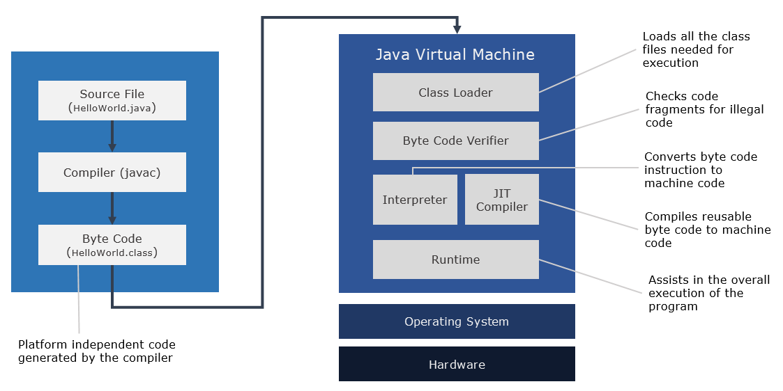
Third Skill

Slide 8
